Slide 1
How effective is media verification in stopping fake news ?

Slide 2
What is fake news ?
Fake news also referred to as hoax news. Deliberately publish hoaxes,propaganda, and disinformation purpoting to be real news. Often using social media to drive web traffic and amplify their effect. It has purpose to mislead in order to gain financially or politically.

Slide 3

Example of fake news
This little boy lives in his
Parent’s grave for 3 years,
until his death is coming

Slide 4
Identifying fake news
Consider the source (to understand its mission and purpose)
Read beyond the headline (to understand the whole story)
Check the authors (to see if they are real and credible)
Assess the supporting sources (to ensure they support the claims)
Check the date of publication (to see if the story is relevant and up to date)
Ask if it is a joke (to determine if it is meant to be satire)
Review your own biases (to see if they are affectiong your judgement)
Ask experts (to get confirmation from independent people with knowledge)

Slide 5
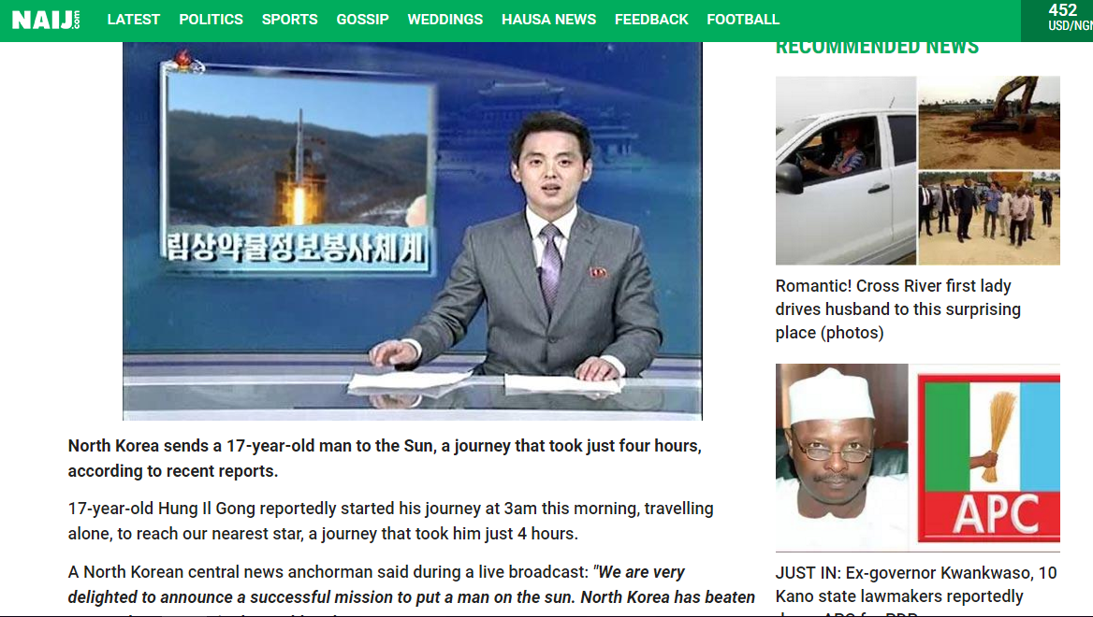
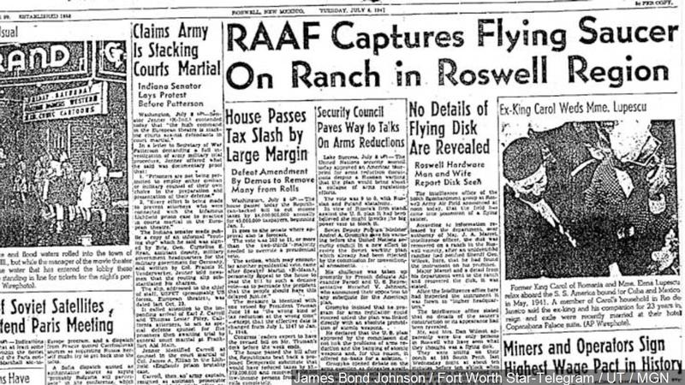
Types of Fake news
Fake news
Mistakes
Fliers
Satire
Gaslighting
Conspiracy Theories – Roswell UFO
Propaganda – North Korea Landed Man on Sun

Slide 6
Function of media
News and Information
Discussion of opinions
Cultural transmision
Entertainment

Slide 7
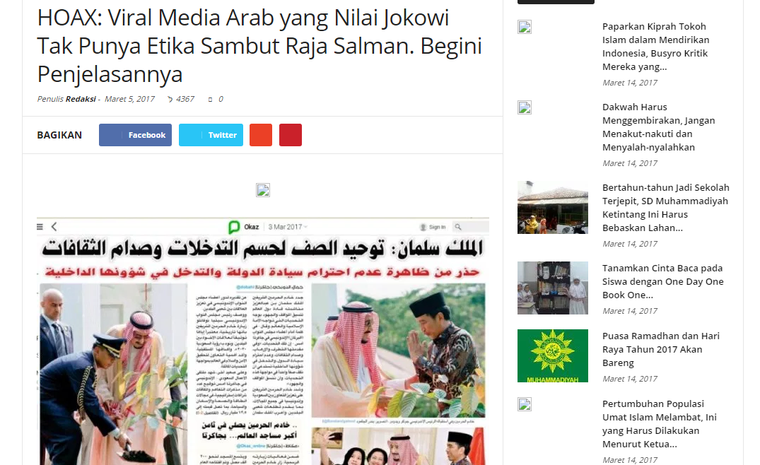
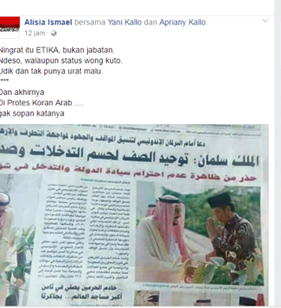
Verification by Media

Slide 8
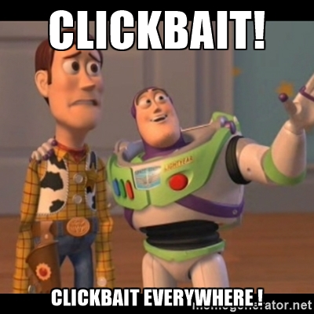

How did they spreading so fast

Slide 9
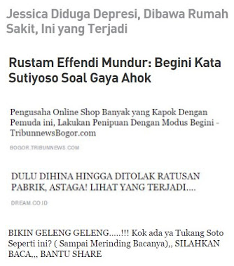
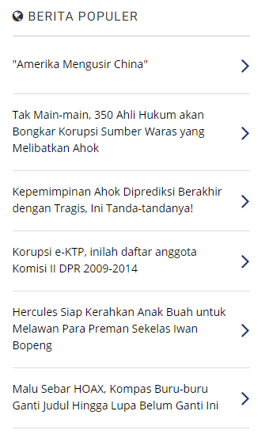
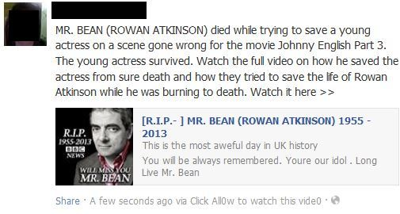
How did they spreading so fast
Clickbait on the internet by media,

Slide 10
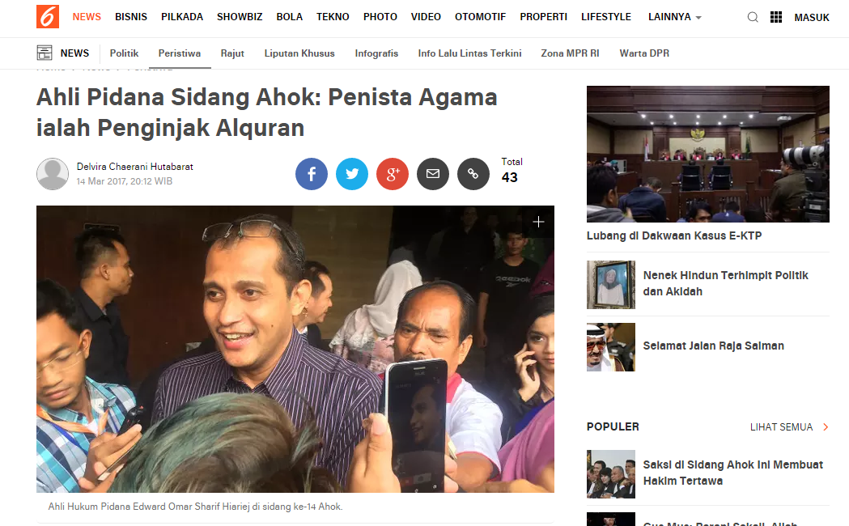
Another Clickbait Example

Slide 11
Even Big Media Like Liputan6 Use Clickbait to Boost the Hit on Their Article

Slide 12
BUT
Conclusion
Yes, Media is effective for busting fake news
Media is also effective in spreading fake news

